Slide 1
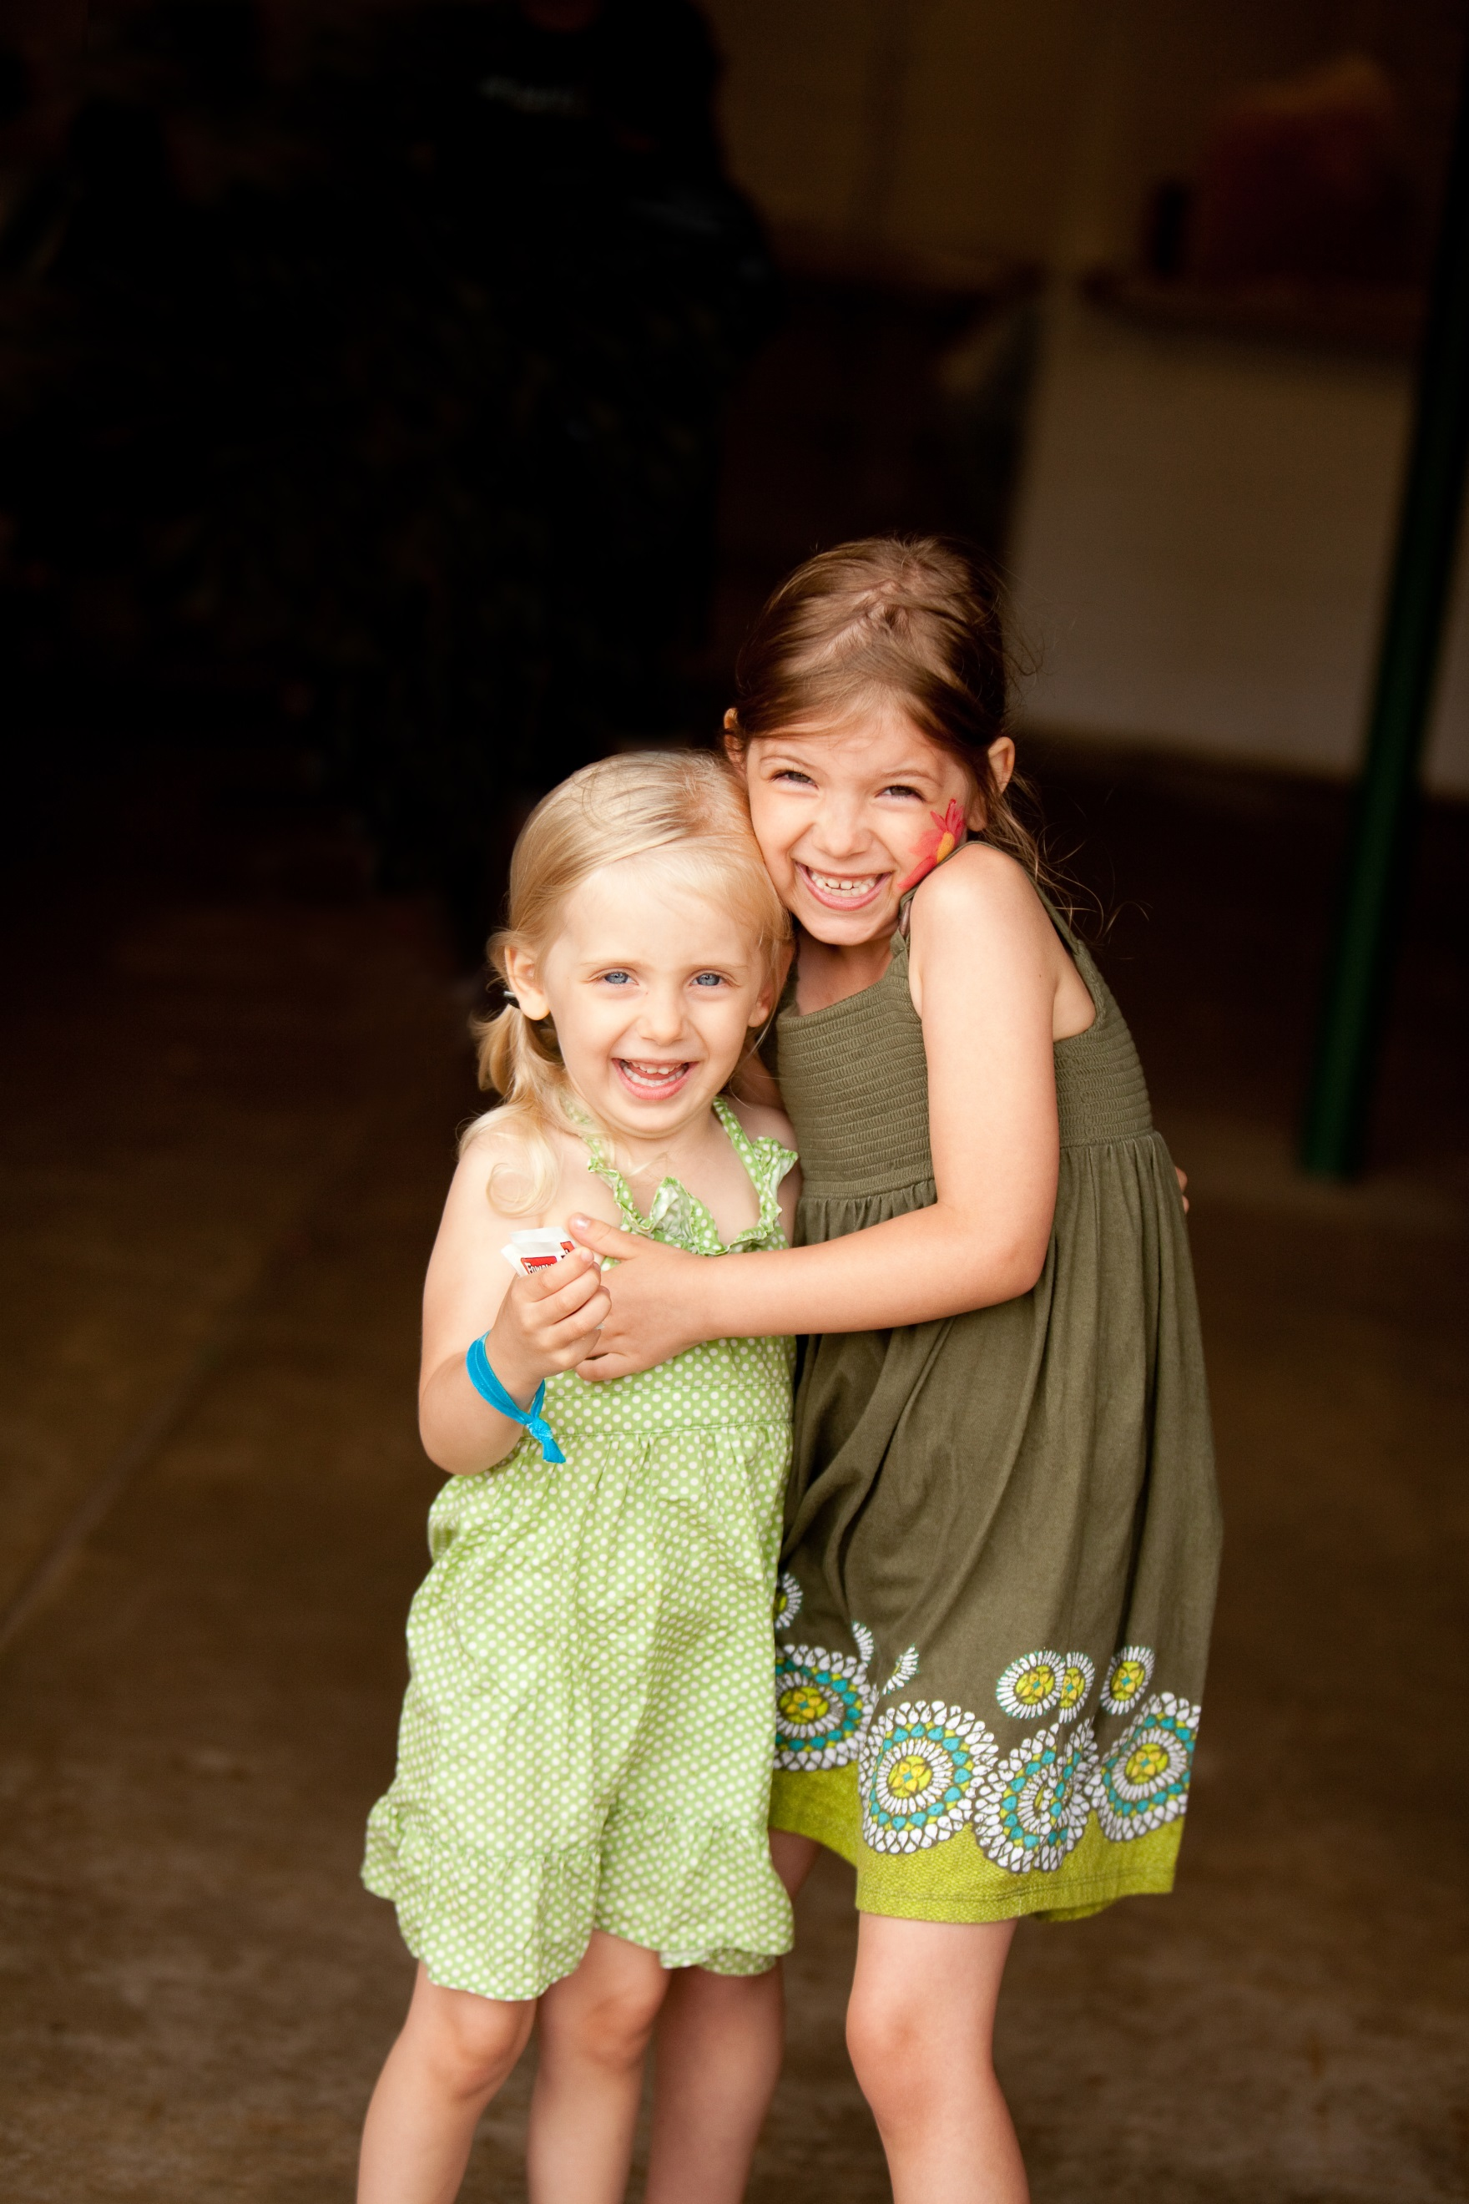
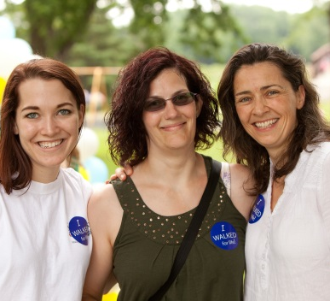
WALK. RUN.
SAVE LIVES!
SATURDAY, JUNE 27
LAKE NOKOMIS
Pick up your sponsor form in the lobby.
Kids Races 9:30 a.m.
Walk & Run 10:00 a.m.
REGISTER AT:
www.nlfs.org
www.nlfs.org
NLFSWalkRun

