Slide 1
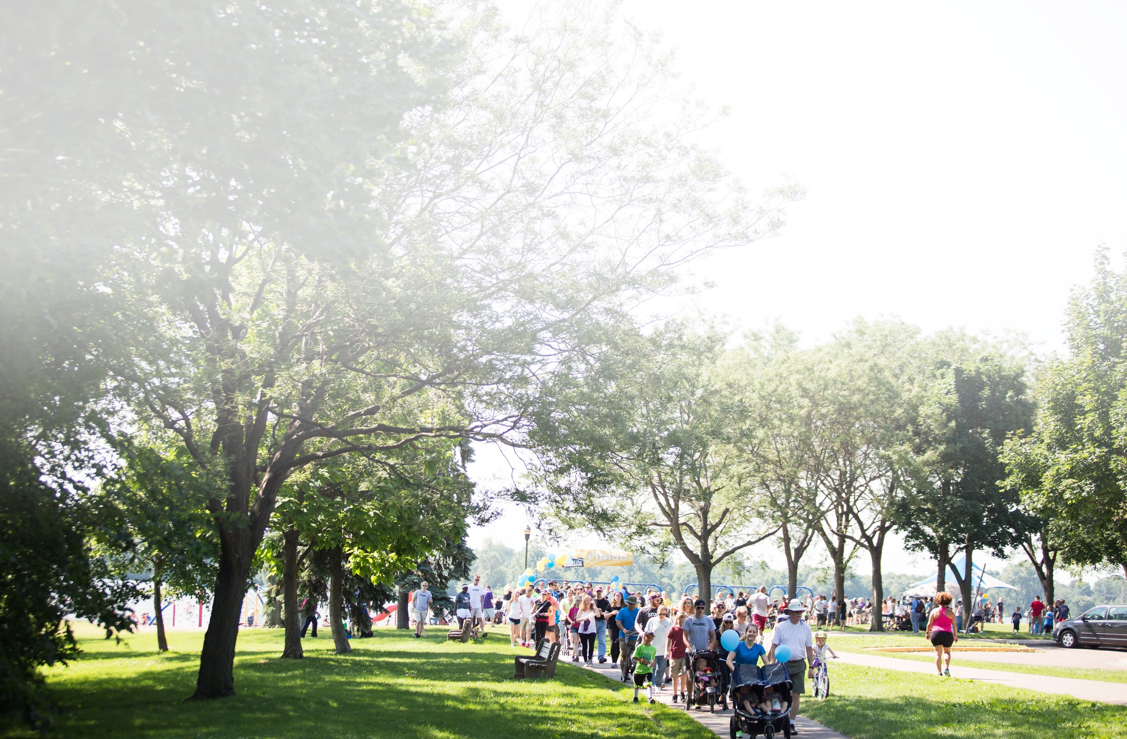
www.nlfs.org
WALK. RUN. SAVE LIVES!
Kids Races 9:30 a.m. • Walk & Fun Run 9:45 a.m.

