Slide 1
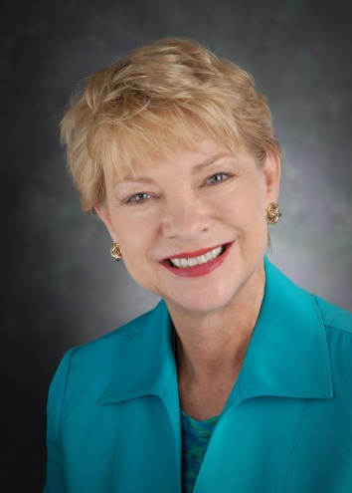
Celebrate
THE VISION
BANQUET & SILENT AUCTION
FRIDAY, OCTOBER 3
6 P.M. AUCTION, 7 P.M. DINNER
KEYNOTE SPEAKER
Carol Everett
Crowne Plaza, Saint Paul
FORMER ABORTION CLINIC OWNER
www.nlfs.org
WWW.NLFS.ORG

